Slide 1
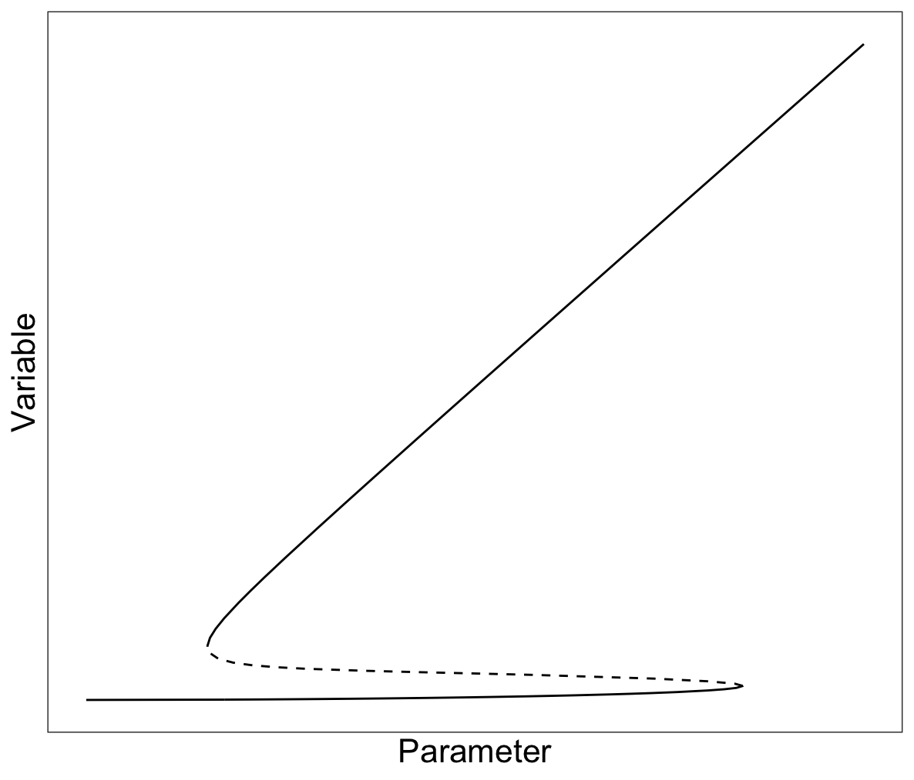
Bifurcations in dynamical systems
Hanna ten Brink
1 October 2025
Notes:
Bifurcation point: Point in parameter space at which a qualitative change in the dynamics takes place

Slide 2
Lecture goals
After this lecture you can
Define three types of bifurcation points often found in ecological systems
Explain the biological meaning of each of these bifurcation type
Recognize each bifurcation point in a one-parameter bifurcation plot
Understand how bifurcation curves appear in a two-parameter bifurcation plot
Relate different representations (time series, isocline diagrams, one-parameter and two-parameter bifurcation plots) to each other

Slide 3
Recap: Which bifurcation points have we seen so far?

Slide 4
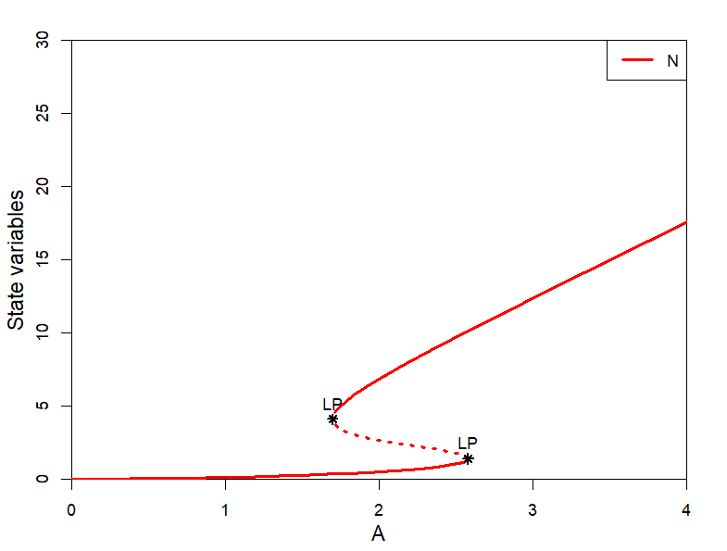
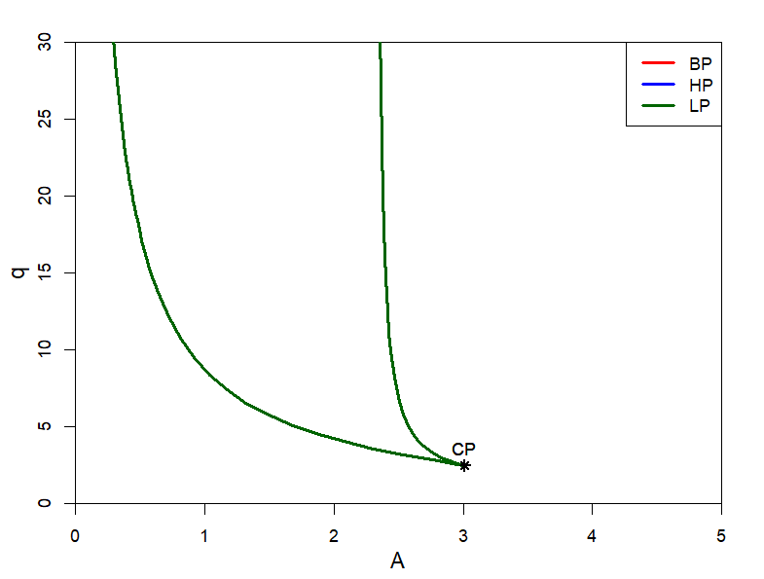
Recap: Which bifurcation points have we seen so far?
Limit points (Spruce-budworm and vegetation catastrophes)
Branching points (Vegetation catastrophes)
Cusp point (Spruce-budworm and vegetation catastrophes)

Slide 5
Branching point
Formally: A branching point is a parameter value where two equilibrium branches cross and exchange their stability
In ecology invasion threshold
Notes:
Discuss R0

Slide 6
Branching points in ecology and evolution
Invasion threshold
Competitors
Predators -> Computerlab 2 (this afternoon)
Infection -> This lecture
Mutants -> Adaptive dynamics (Friday)

Slide 7
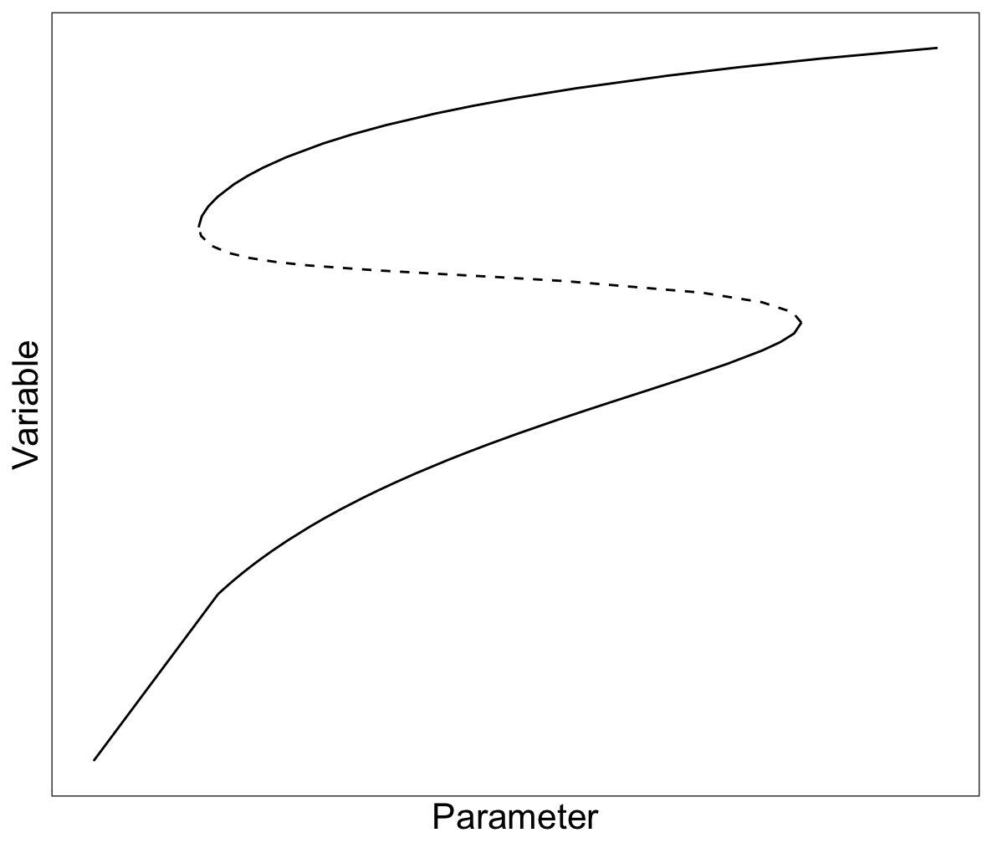
Limit point
At a limit point a stable and unstable equilibrium merge and disappear
Notes:
Discuss ASS/tipping points

Slide 8
Limit point
Alternative stable states
Hysteresis

Slide 9
How to proof the existence of alternative stable states?
Different outcomes with different initial conditions
Change in state after pertubation
Different parameter thresholds for back- and forward shifts
Notes:
Beter plaatje maken
Alleen als er tijd is

Slide 10
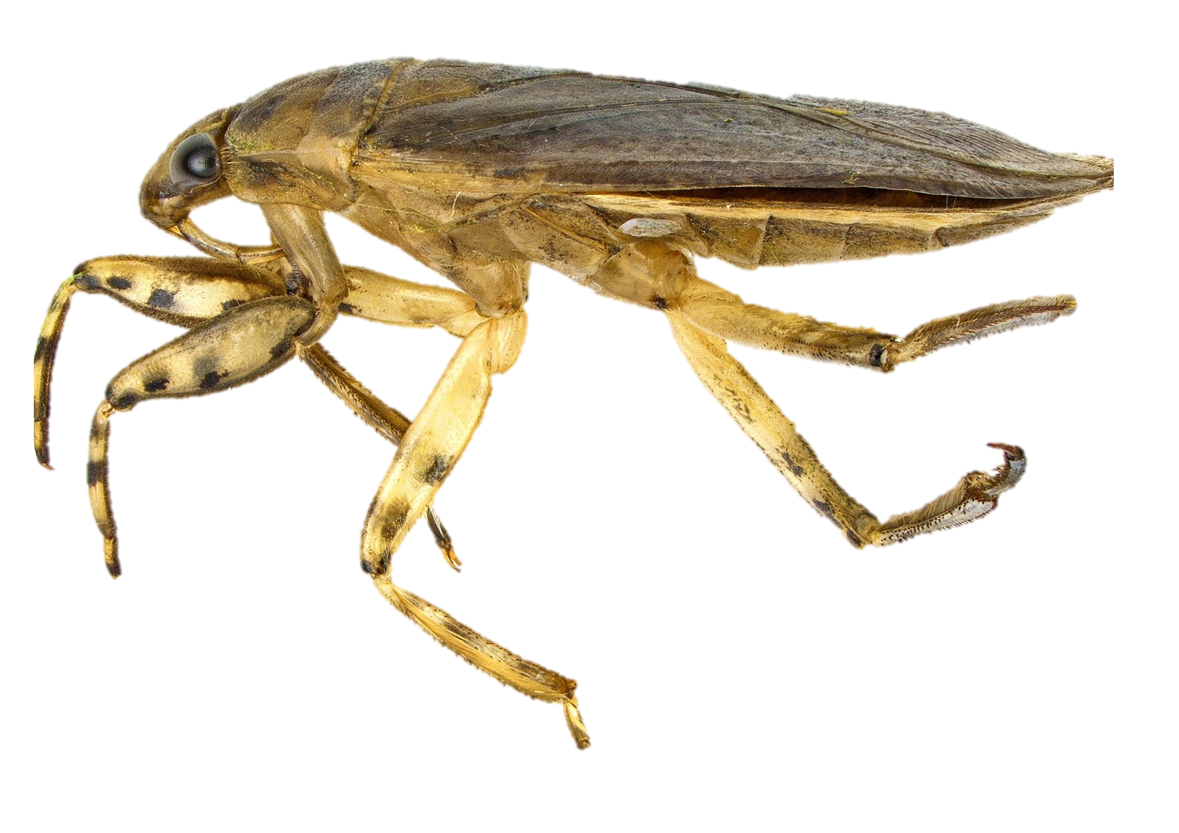
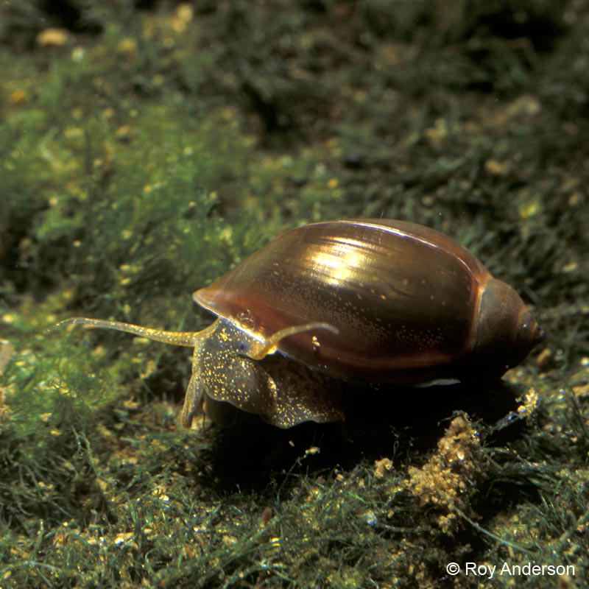
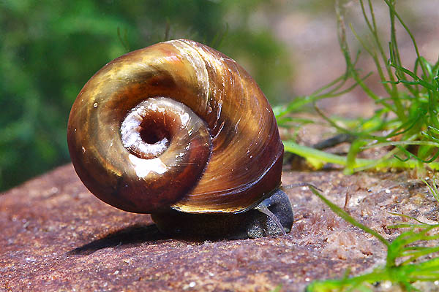
Example of alternative steady states
Physella gyrina
Belostoma flumineum
Helisoma trivolvis
Chase (2003)
Notes:
Predator
Physella vulnerable
Helisoma only when juvenile
Differnet productivity levels

Slide 11
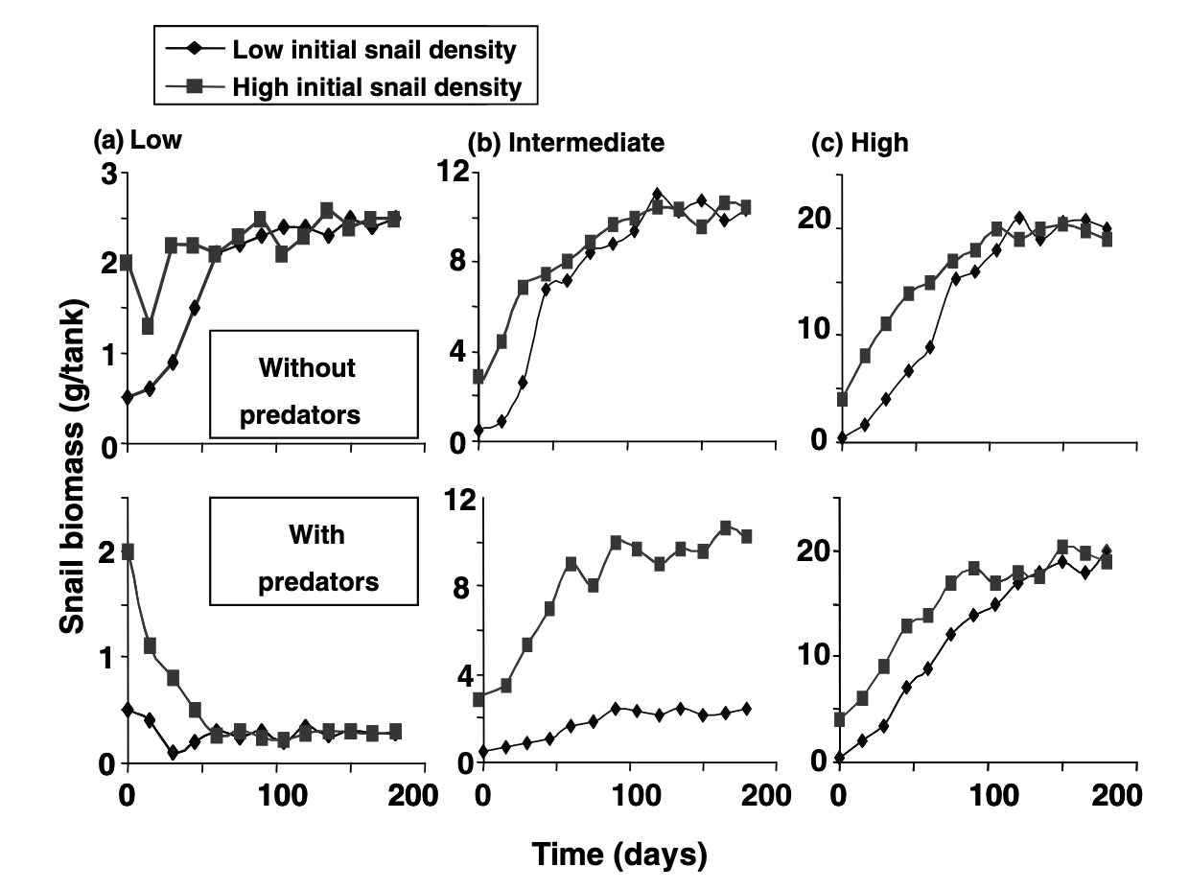
Chase (2003)

Slide 12
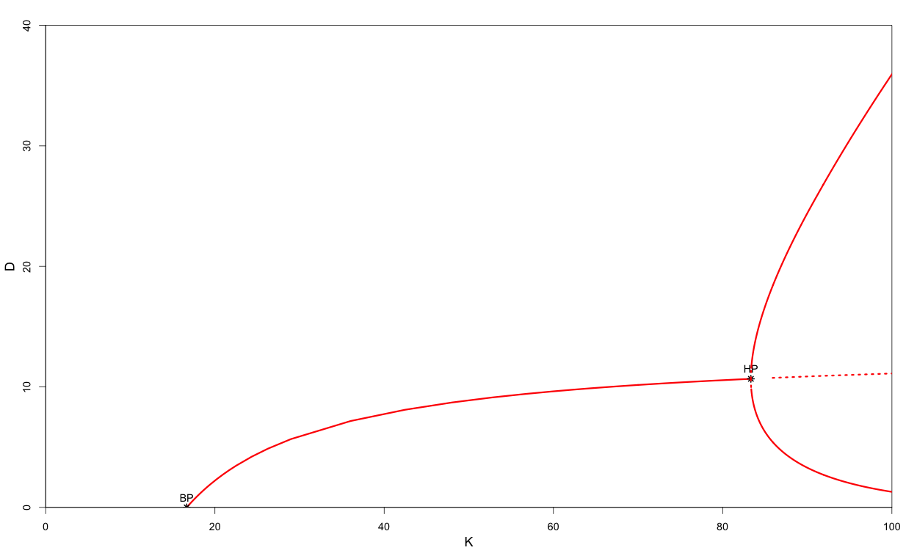
Hopf point
At a hopf bifurcation, the stability of an equilibrium changes, and a limit cycle (oscillations) emerges
Notes:
Predator-prey
At the Hopf bifurcation, the equilibrium changes stability from stable to unstable (or from unstable to stable) and a limit cycle emerges.

Slide 13
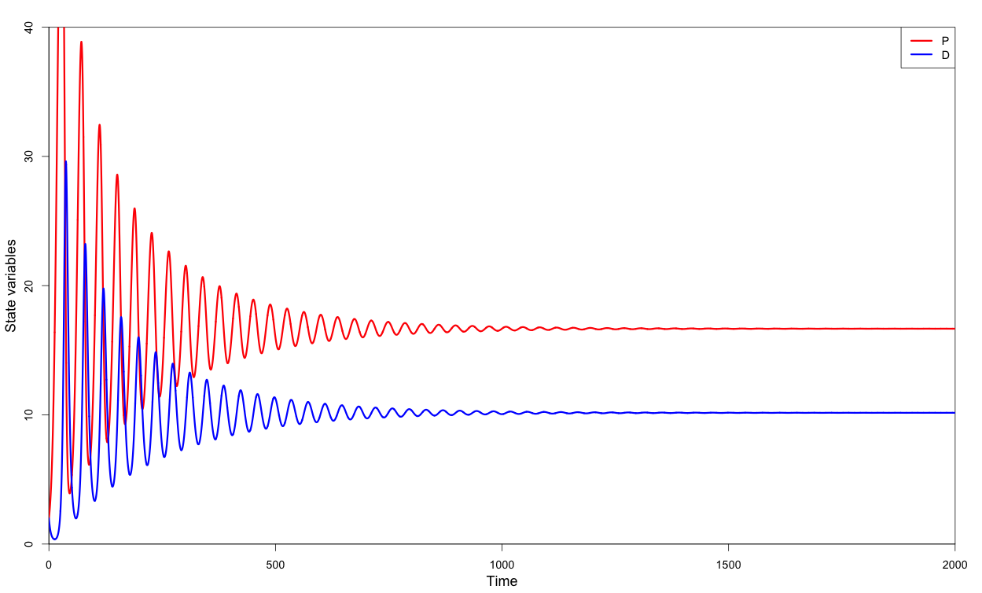
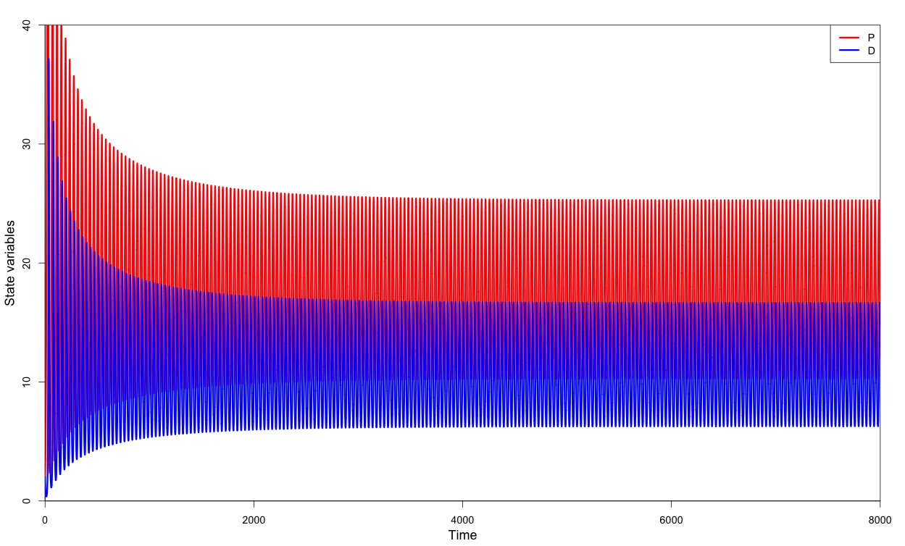
Hopf point
At a hopf bifurcation, the stability of an equilibrium changes, and a limit cycle (oscillations) emerges
Notes:
Predator-prey
At the Hopf bifurcation, the equilibrium changes stability from stable to unstable (or from unstable to stable) and a limit cycle emerges.

Slide 14
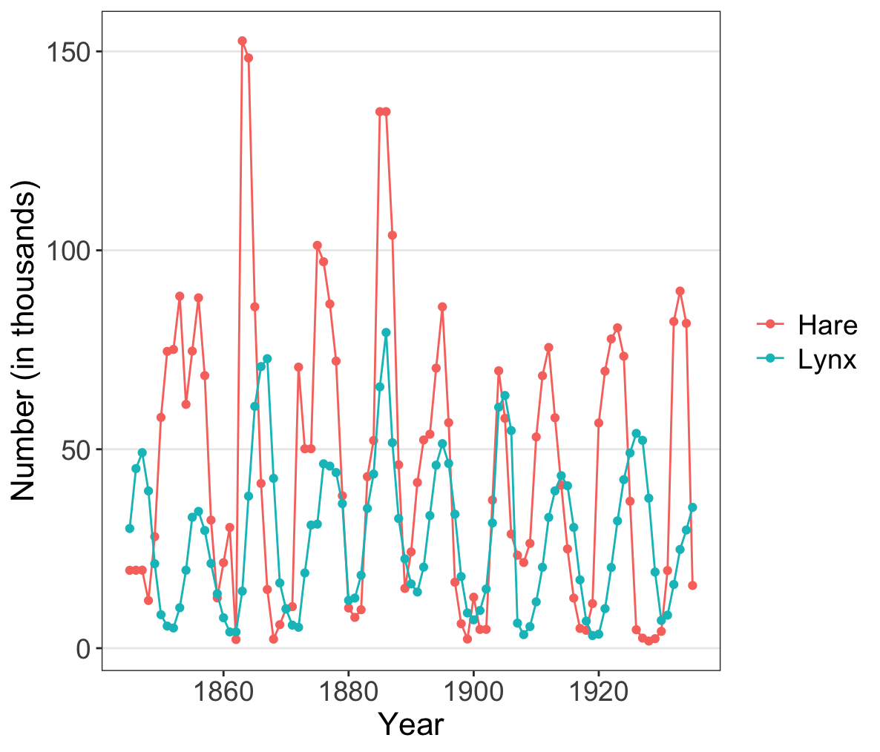
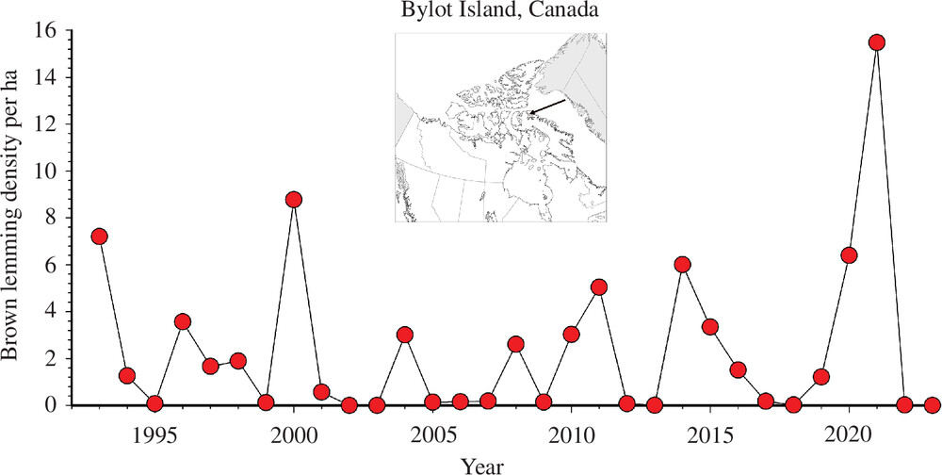
Examples of limit cycles
Brown lemming fluctuations, Bylot Island (Canada) Gauthier et al. (2024)

Slide 15
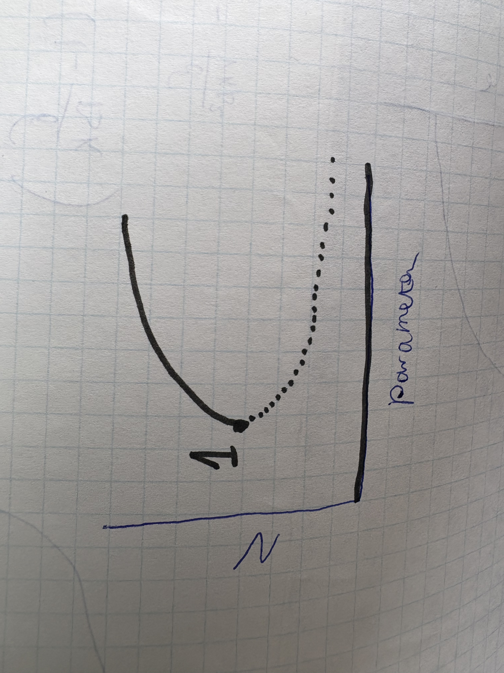
Bifurcation quiz

Slide 16
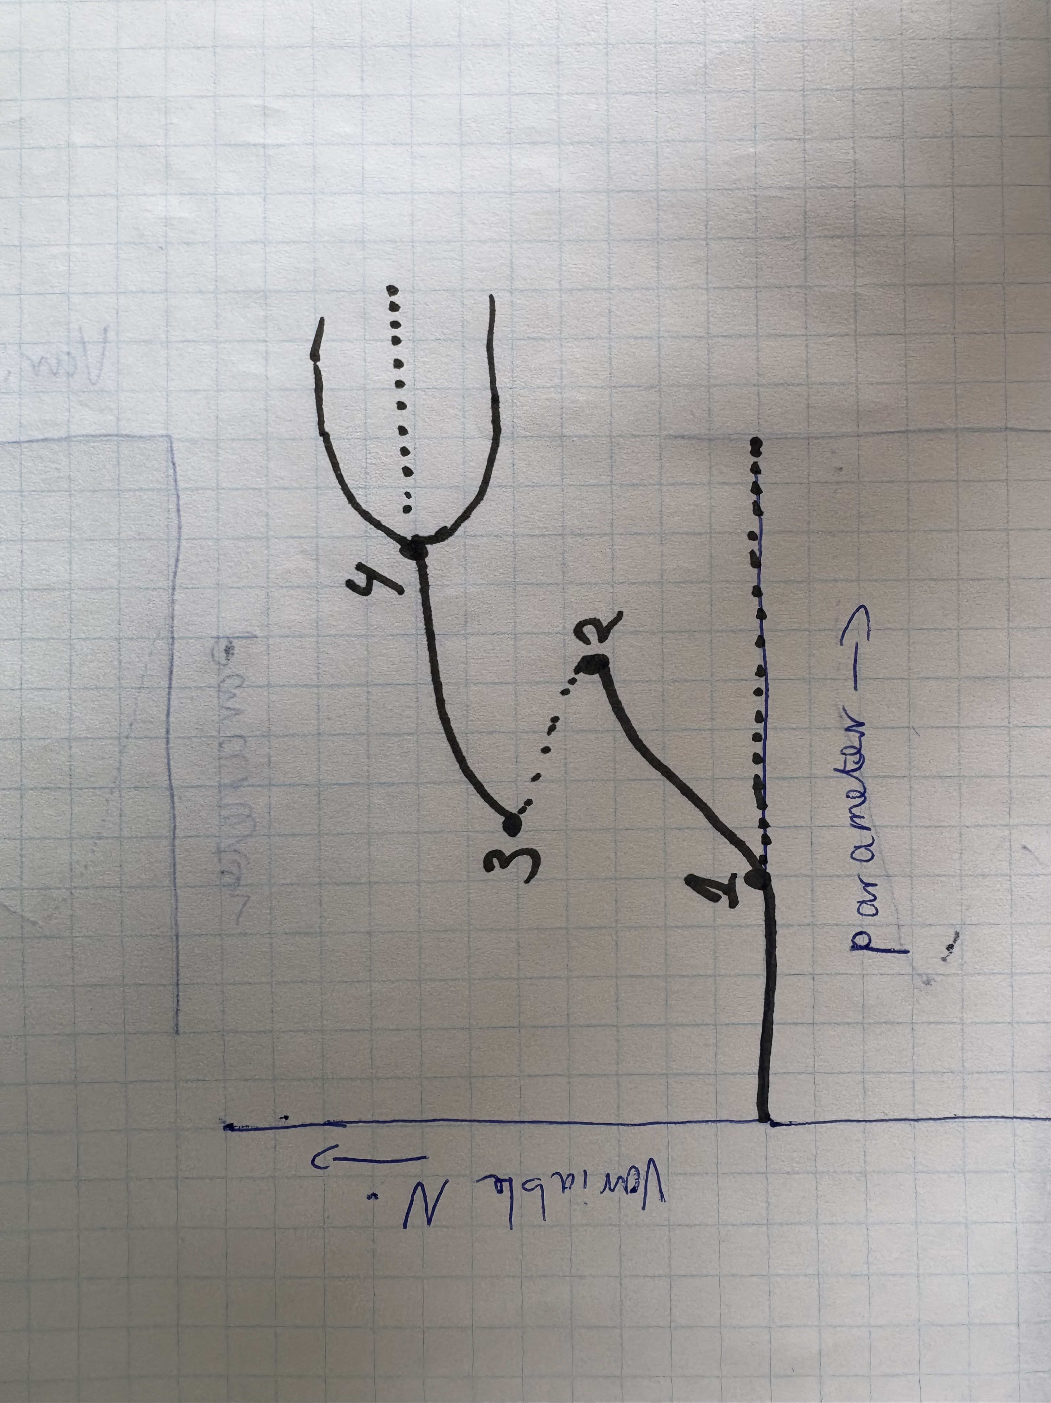
Bifurcation quiz

Slide 17
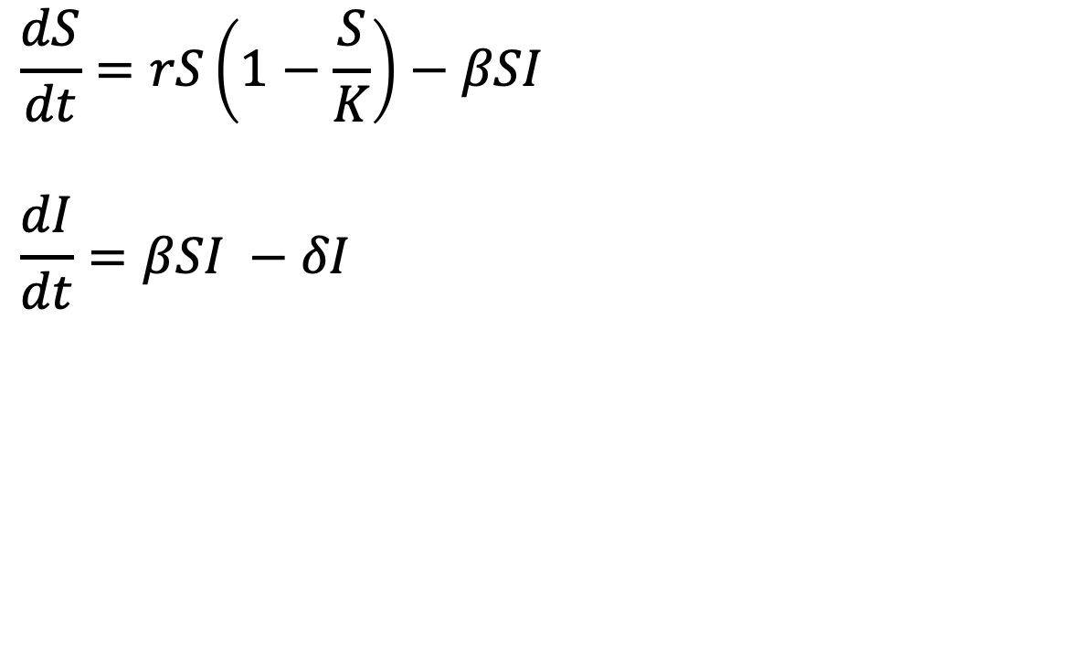
Branching point in an epidemic model
$$\frac{dS}{dt}=rS\left(1−\frac{S}{K}\right)−βSI$$
$$\frac{dI}{dt}=βSI −δI$$

Slide 18
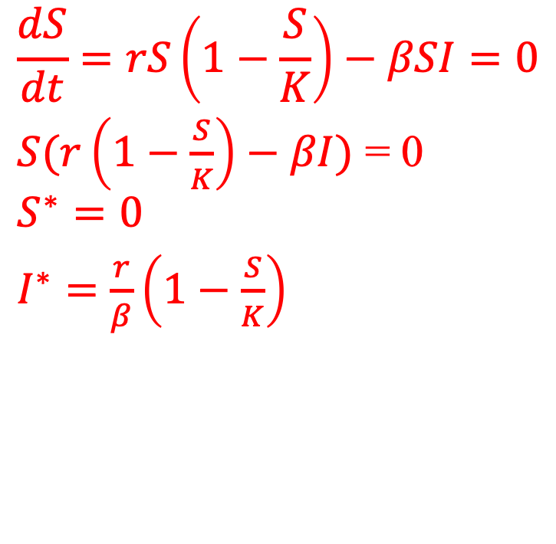

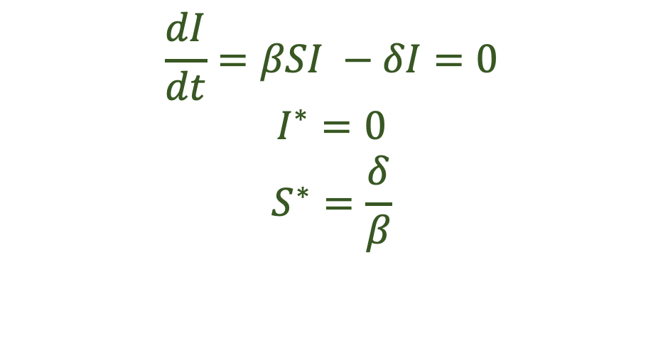
Branching point in an epidemic model
$$\frac{dS}{dt}=rS\left(1−\frac{S}{K}\right)−βSI=0$$
$S(r\left(1−\frac{S}{K}\right)−βI)$ = 0
$$S^{∗}=0$$
$I^{∗}=$ $\frac{r}{β}\left(1−\frac{S}{K}\right)$
$$\frac{dI}{dt}=βSI −δI=0$$
$$I^{∗}=0$$
$$S^{∗}=\frac{δ}{β}$$
Trivial equilibrium S* = 0, I* = 0
Disease free equilibrium: S* = K, I* = 0
Endemic equilibrium: $S^{∗}=\frac{δ}{β}, I^{∗}=\frac{r}{β}\left(1 − \frac{δ}{βK}\right)$
Draw all possible configurations of the phaseplane
Notes:
Draw all possible configurations of the phaseplane

Slide 19


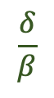
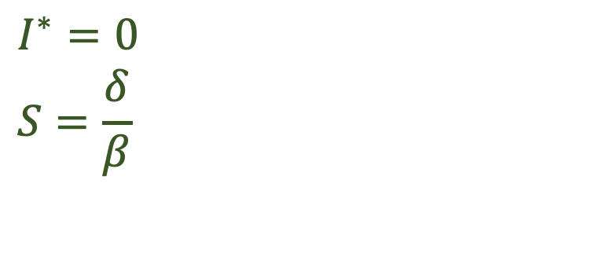
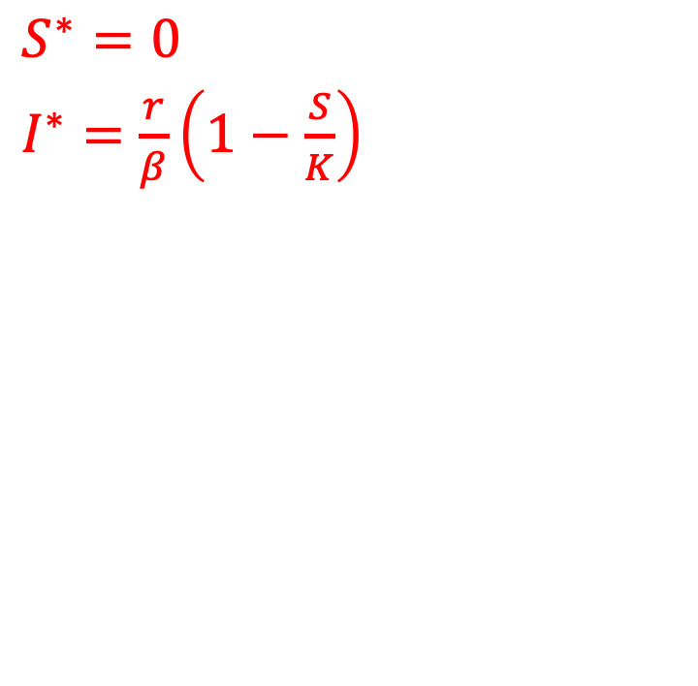
Phaseplane of the epidemic model
$$S^{∗}=0$$
$I^{∗}=$ $\frac{r}{β}\left(1−\frac{S}{K}\right)$
$$I^{∗}=0$$
$$S=\frac{δ}{β}$$
$$\frac{r}{β}$$
$$K$$
$$\frac{δ}{β}$$
Notes:
R(1-S/K) – B*I
R –RS/K – BI
R – BI = RS/K
K – KB/R I = S

Slide 20

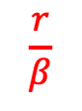
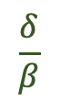
Phaseplane of the epidemic model
$$S^{∗}=0$$
$I^{∗}=$ $\frac{r}{β}\left(1−\frac{S}{K}\right)$
$$I^{∗}=0$$
$$S=\frac{δ}{β}$$
$$\frac{r}{β}$$
$$\frac{δ}{β}$$
$$K$$
Notes:
R(1-S/K) – B*I
R –RS/K – BI
R – BI = RS/K
K – KB/R I = S

Slide 21

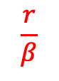
Phaseplane of the epidemic model
$$S^{∗}=0$$
$I^{∗}=$ $\frac{r}{β}\left(1−\frac{S}{K}\right)$
$$I^{∗}=0$$
$$S=\frac{δ}{β}$$
$$\frac{r}{β}$$
$$\frac{δ}{β}$$
$$K$$
Notes:
R(1-S/K) – B*I
R –RS/K – BI
R – BI = RS/K
K – KB/R I = S

Slide 22
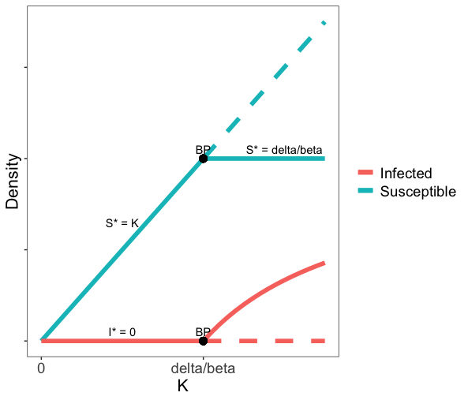
Summarize the different phaseplanes in a bifurcation graph as a function of K

Slide 23
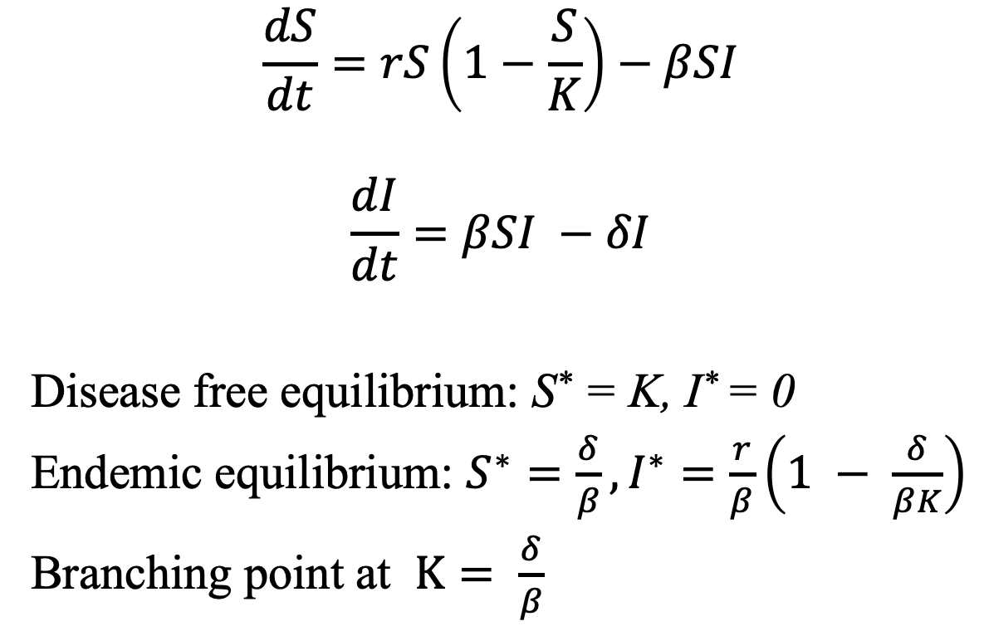
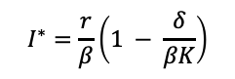
Branching point in an epidemic model
$$\frac{dS}{dt}=rS\left(1−\frac{S}{K}\right)−βSI$$
$$\frac{dI}{dt}=βSI −δI$$
Disease free equilibrium: S* = K, I* = 0
Endemic equilibrium: $S^{∗}=\frac{δ}{β},I^{∗}=\frac{r}{β}\left(1 − \frac{δ}{βK}\right)$
Branching point at $K= \frac{δ}{β}$
$$I^{∗}=\frac{r}{β}\left(1 − \frac{δ}{βK}\right)$$

Slide 24
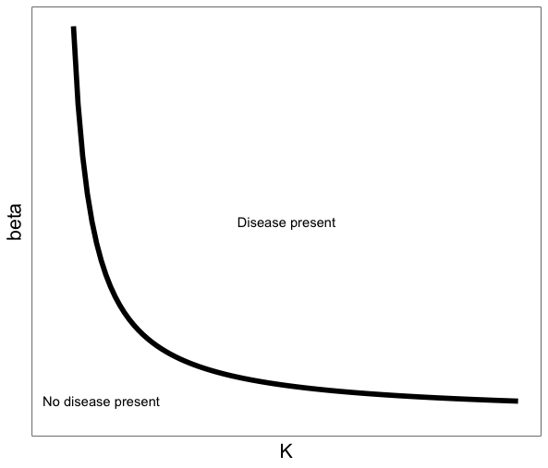
Branching points in a two-parameter plot
Notes:
Add another bif with different beta

Slide 25
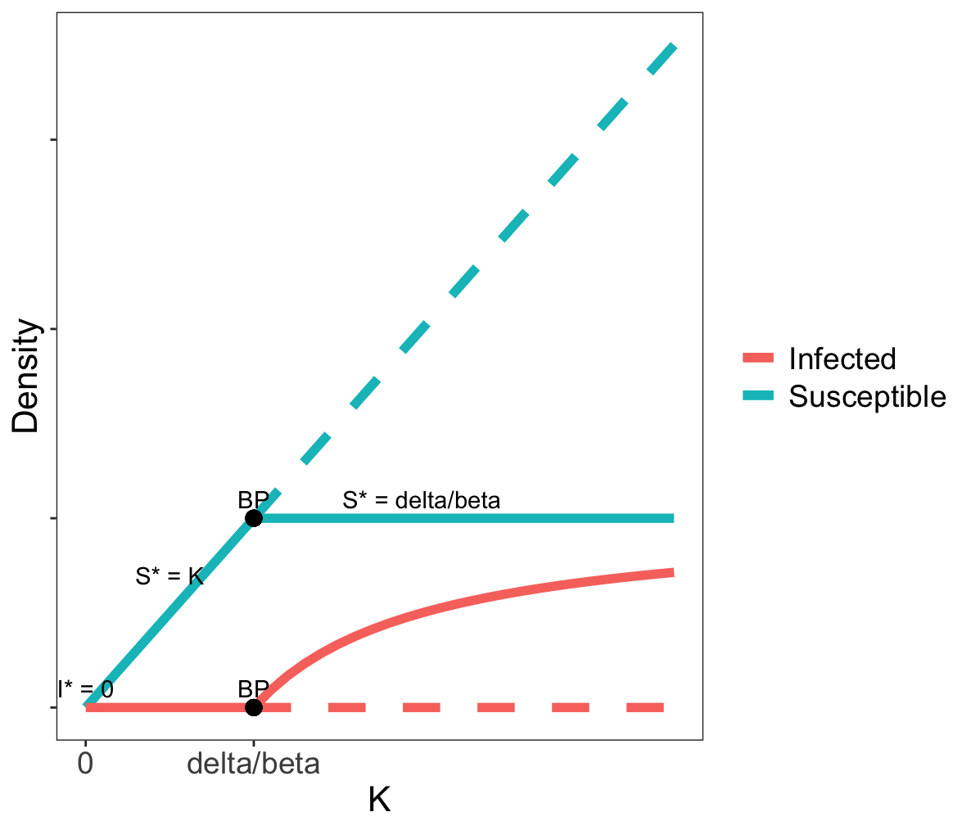
Branching points in a two-parameter plot
Notes:
Add another bif with different beta

Slide 26
Draw a bifurcation plot over beta

Slide 27
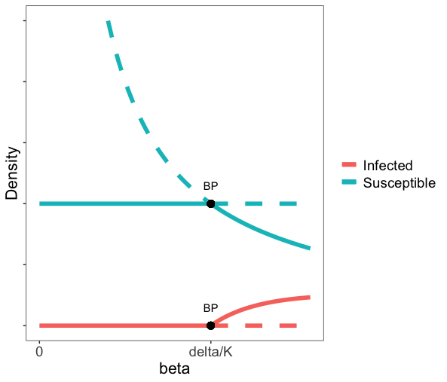
Draw a bifurcation plot over beta
Notes:
Beta = delta/K
Disease free equi independent of beta, so a straight line
S decreases with beta
r/beta – delta*r/(beta^2K)
-r/beta^2 + 2*delta*R/(K*beta^3) (derivative)
r/beta^3 (2*delta/K – beta)
As long as beta < 2*delta/K I increases as a function of beta, after that it decreases)

